Slide 1


AMAZON FRESH ANALYTICS…
G. KIRUTHIK CHAKRA | BADM-WD-T-B9

Slide 2
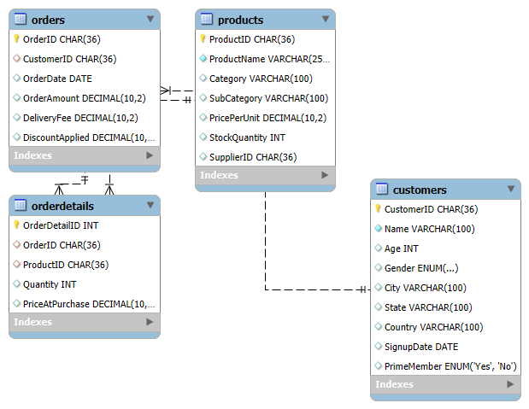
DATA MODELING AND BASIC QUERIES TASK-1
Create an ER diagram for the Amazon Fresh database to understand the relationships between tables (e.g., Customers, Products, Orders).
RESULTS:

Slide 3
TASK-2
Identify the primary keys and foreign keys for each table and describe their relationships.
RESULTS:
Here are the primary keys (PK) and Foreign Keys (FK) for the each table, along with their relationships.
1.Customers Table:
Primary key : customer ID
Relationships:
One customer can place multiple orders
Customer ID in the orders table is a foreign key referring to customer ID in customers.

Slide 4
2.Products Table:
Primary key: Product ID
Relationships:
A product can be part of multiple orders.
Product ID in order detail is a foreign key referring to product ID in products.
3.Orders Table:
Primary key: Order ID
Foreign Key: Customer ID (References customers. customer Id)
Relationships:
Each order belongs to one customer.
Each order can contain multiple products (through order details).

Slide 5
4.Order Details Table (Many –to-Many relationship between orders and products):
Primary key: Order Detail ID
Foreign Key:
Order ID (References orders. orders Id)
Product ID (Reference Products. Products ID)
Relationships:
Connects orders and products , allowing multiple products in one order.
Entity Relationships :
1.One-to-Many (Customer Orders)
A customer can place multiple orders, but each order belongs to one customer.
2.Many-to-Many (Orders products via order details)
Each order can contain multiple products, and each product can be part of multiple orders.

Slide 6
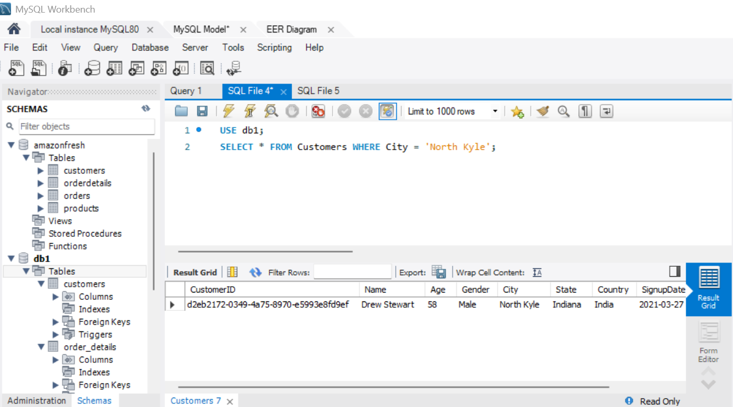
WRITE A QUERY TO TASK-3
1.Retrieve all customers from a specific city.
RESULTS:

Slide 7
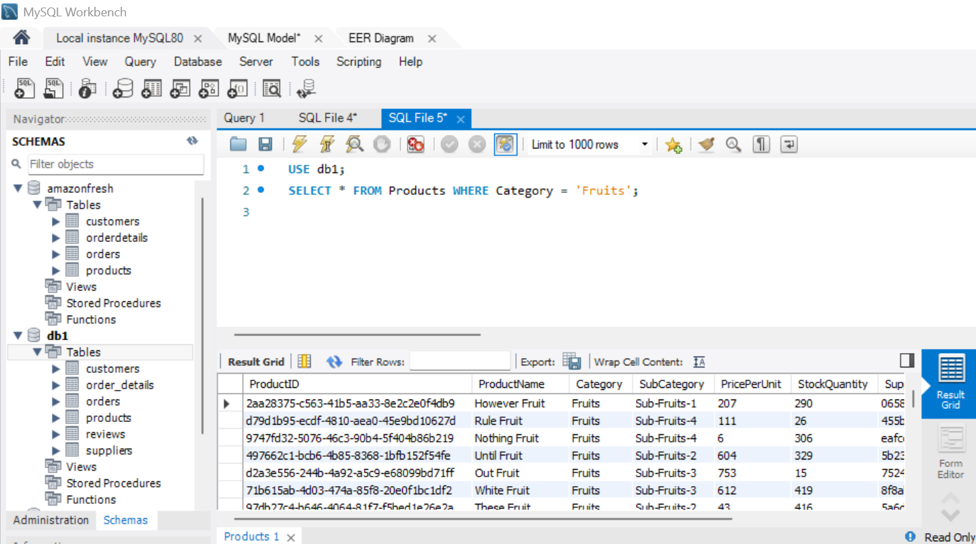
2. Fetch all products under the "Fruits" category.
RESULTS:

Slide 8
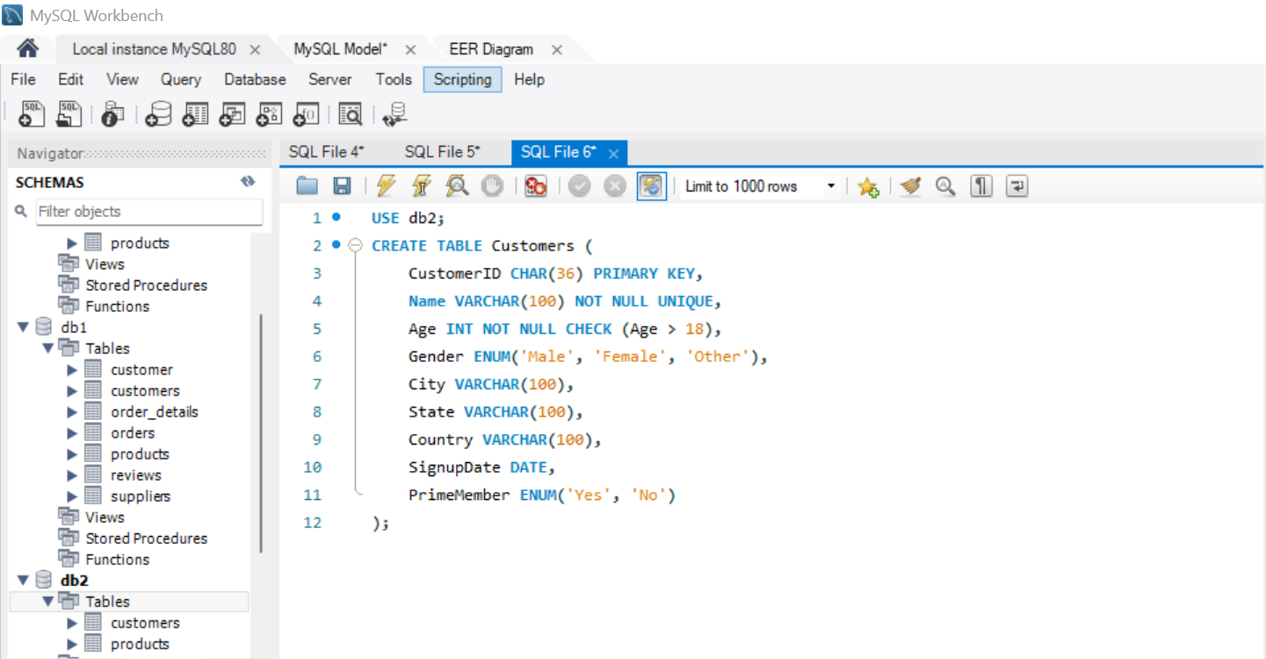
DATA DEFINITION LANGUAGE (DDL) and CONSTRAINTS. TASK-4
Write DDL statements to recreate the Customers table with the following constraints:
1.CustomerID as the primary key.
RESULTS:

Slide 9
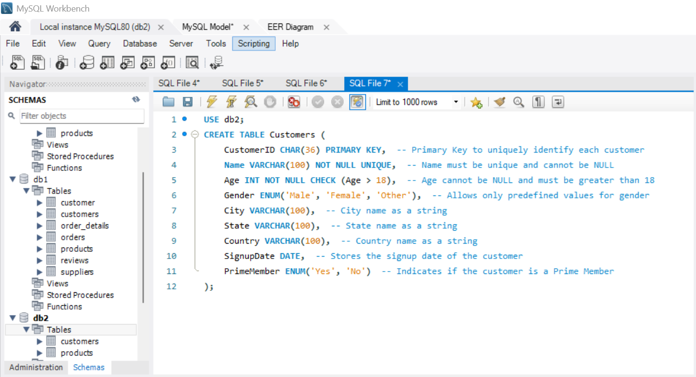
2. Ensure Age cannot be null and must be greater than 18.
RESULTS:

Slide 10
3. Add a unique constraint for Name.
RESULTS: Constraints Applied:
1. Primary Key: customer ID is the Primary Key.
2. Age Constraint:
NOT NULL ensures Age cannot be empty.
CHECK (Age>18) ensures only customers older than 18 can be inserted.
3. Unique Constraint: Name must be Unique (UNIQUE)

Slide 11
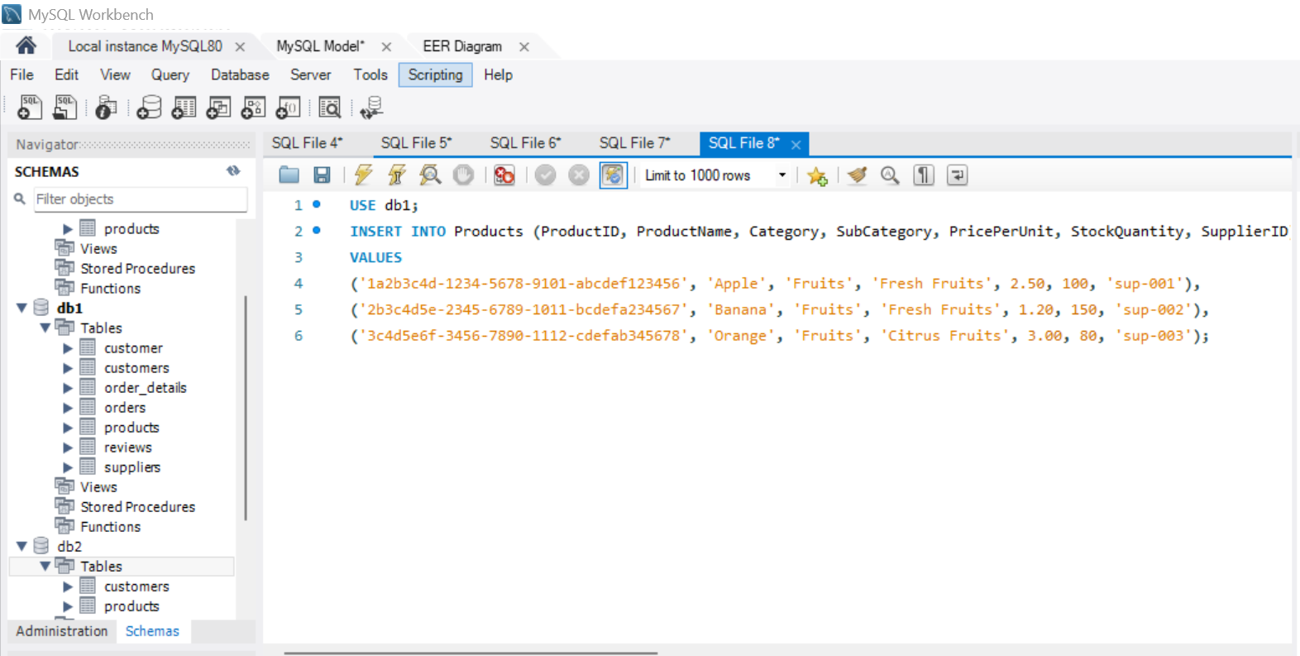
DATA MANIPULATION LANGUAGE(DML) TASK-5
Insert 3 new rows into the Products table using INSERT statements.
RESULTS:

Slide 12
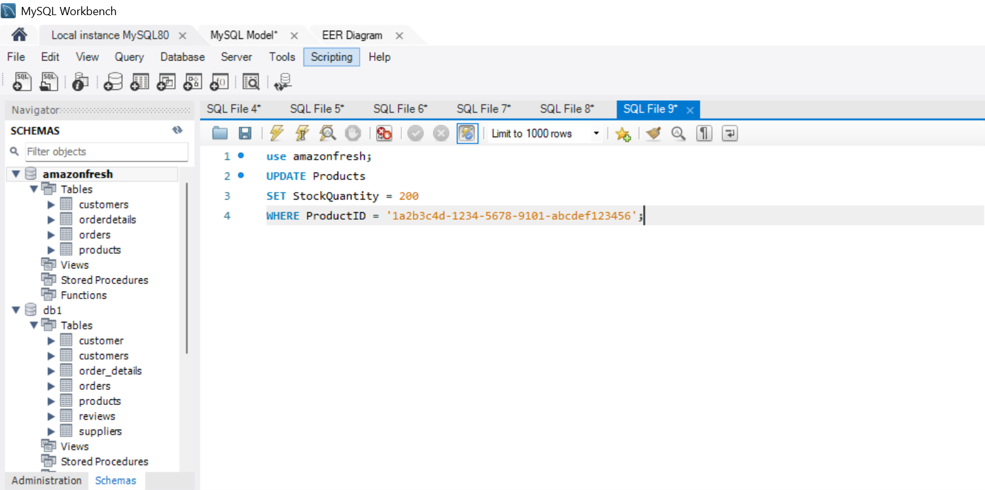
TASK-6
Update the stock quantity of a product where ProductID matches a specific ID.
RESULTS:

Slide 13
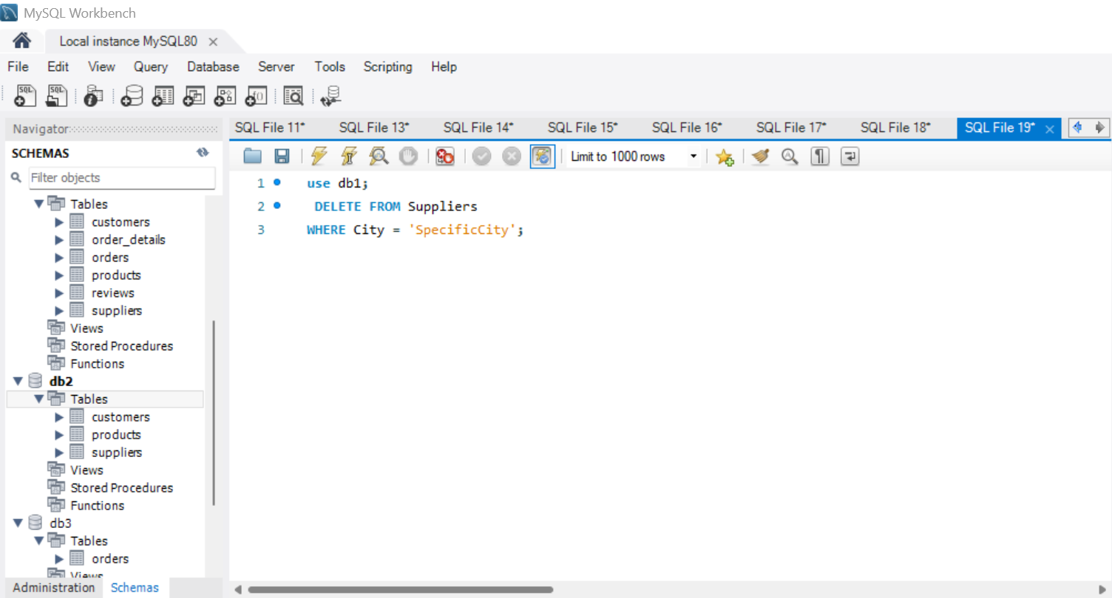
TASK-7
Update the stock quantity of a product where ProductID matches a specific ID.
RESULTS:

Slide 14
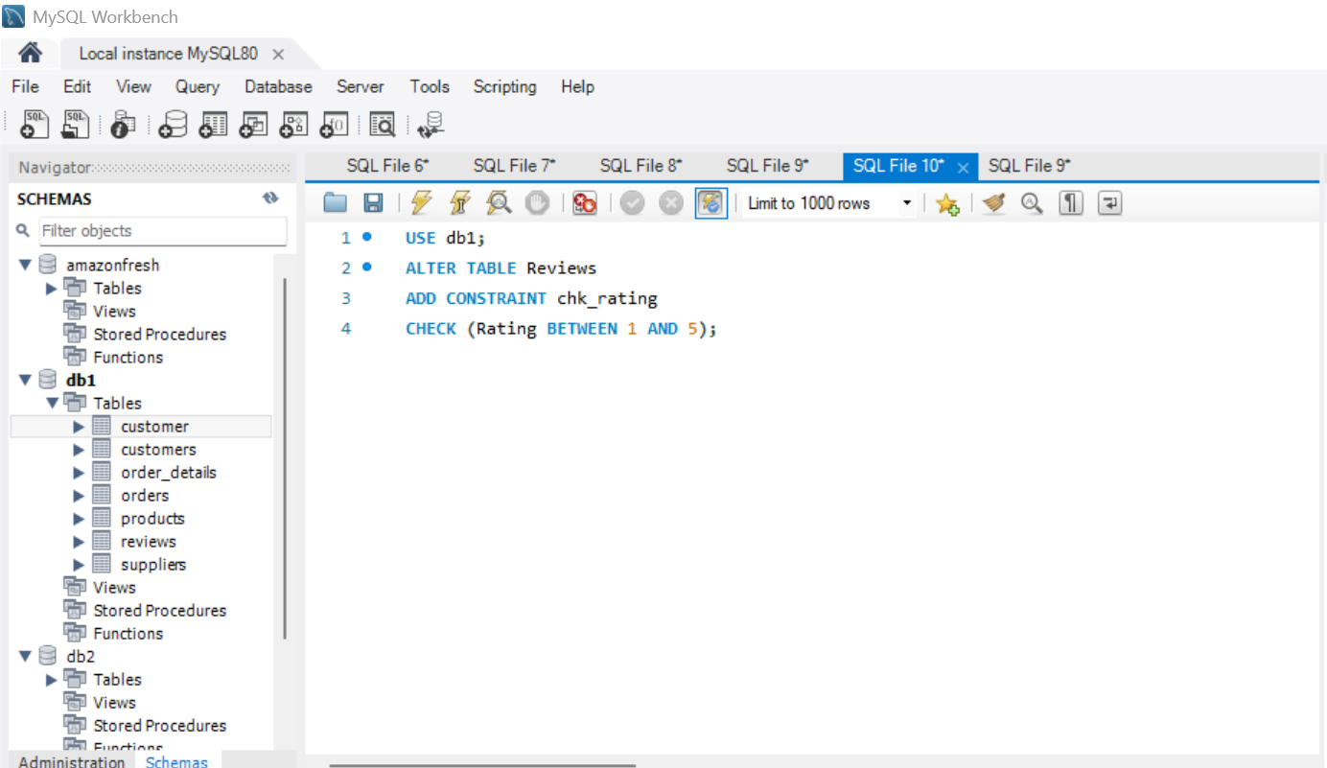
SQL CONSTRAINTS AND OPERATORS TASK-8
Use SQL constraints to:
1.Add a CHECK constraint to ensure that ratings in the Reviews table are between 1 and 5.
RESULTS:

Slide 15
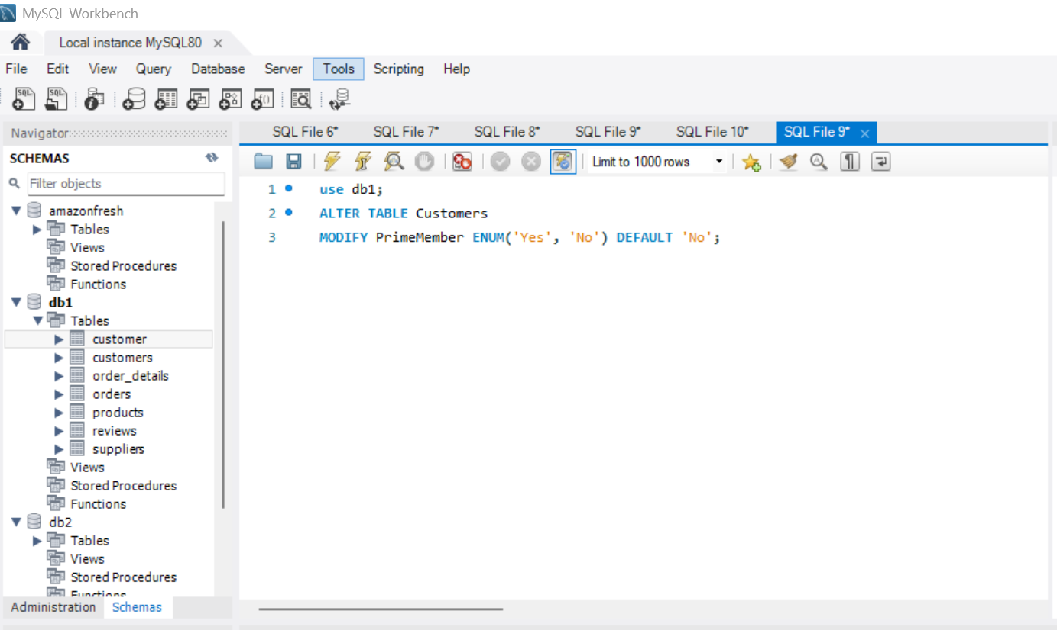
2. Add a DEFAULT constraint for the PrimeMember column in the Customers table (default value: "No").
RESULTS:

Slide 16
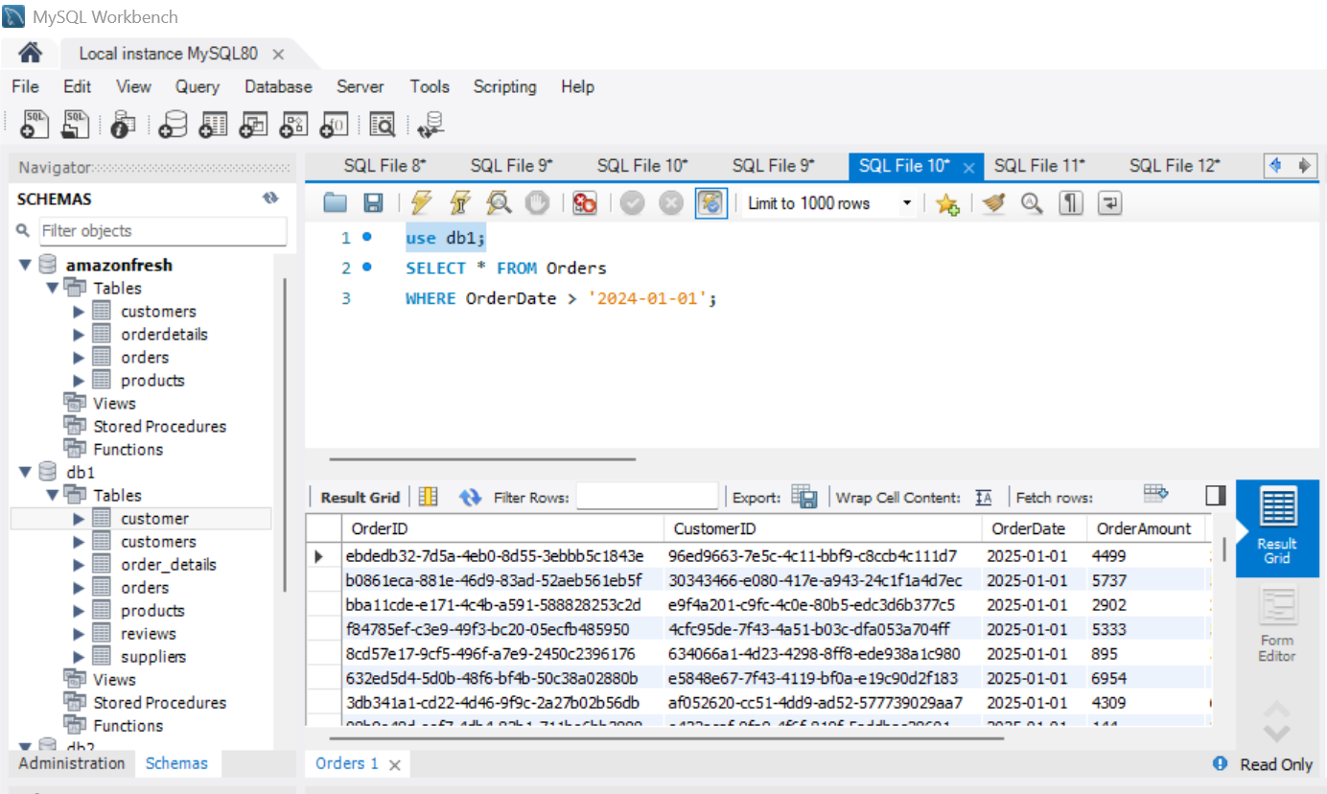
CLAUSES AND AGGREGATIONS TASK-9
Write queries using:
1. WHERE clause to find orders placed after 2024-01-01.
RESULTS:

Slide 17
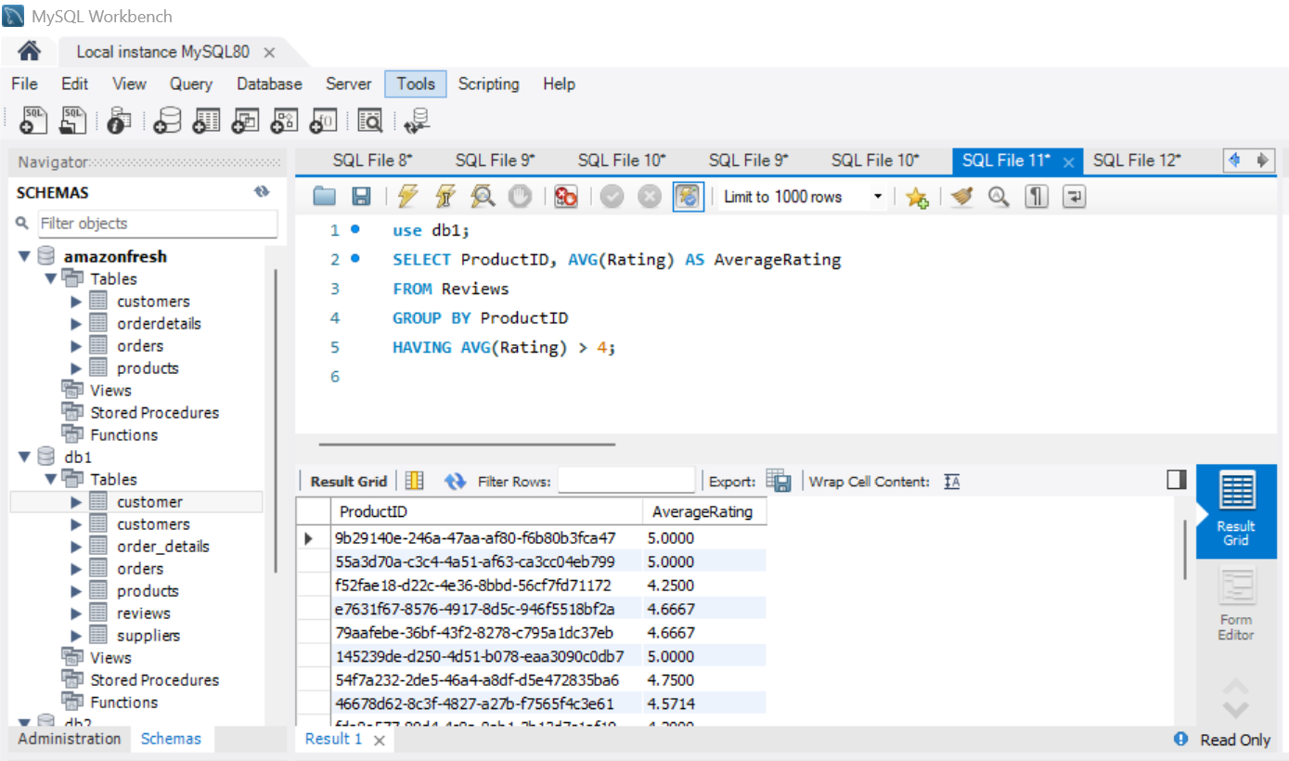
2. HAVING clause to list products with average ratings greater than 4.
RESULTS:

Slide 18
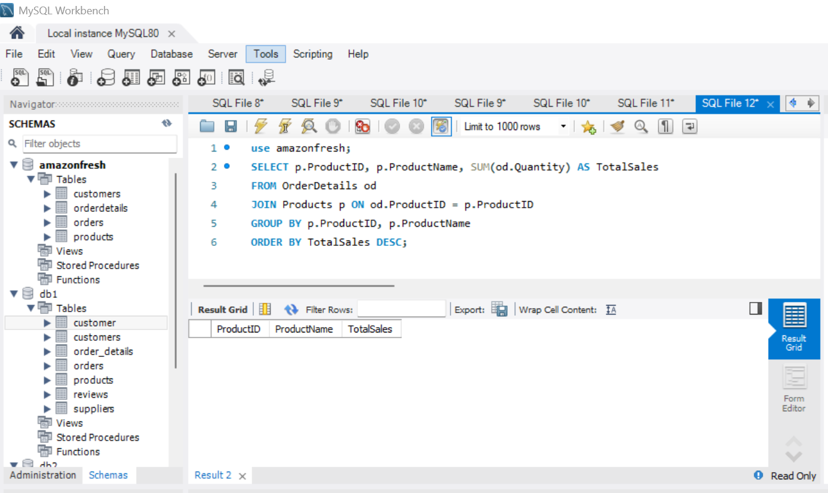
3.GROUP BY and ORDER BY clauses to rank products by total sales.
RESULTS:

Slide 19
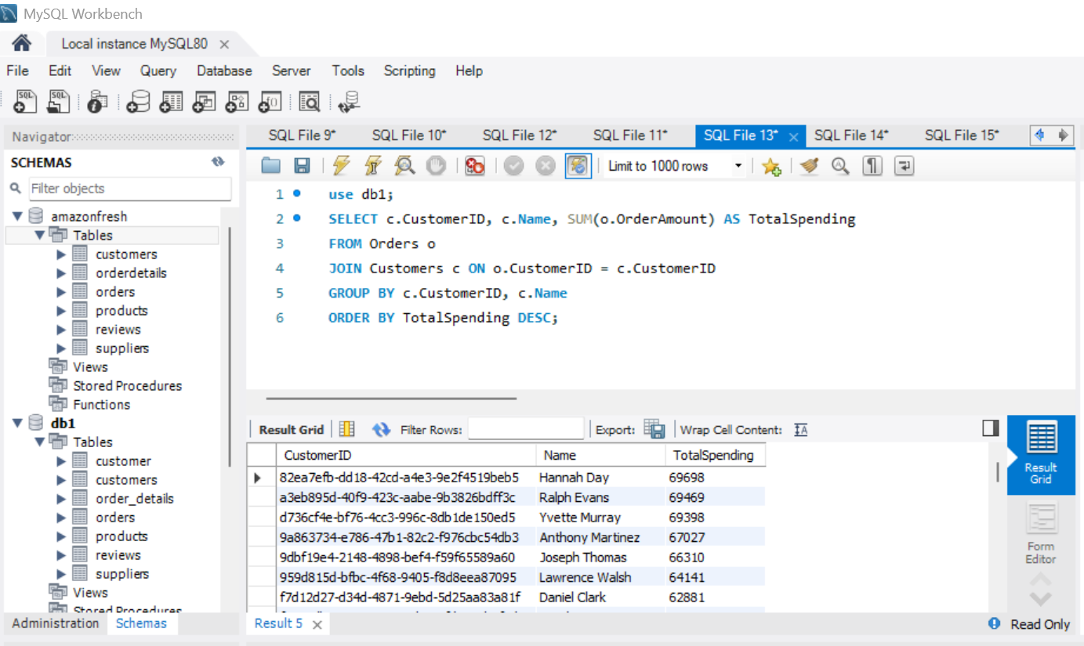
IDENTIFYING HIGH-VALUE CUSTOMERS TASK-10
Scenario:
Amazon Fresh wants to identify top customers based on their total spending. We will:
1.Calculate each customer's total spending.
RESULTS:

Slide 20
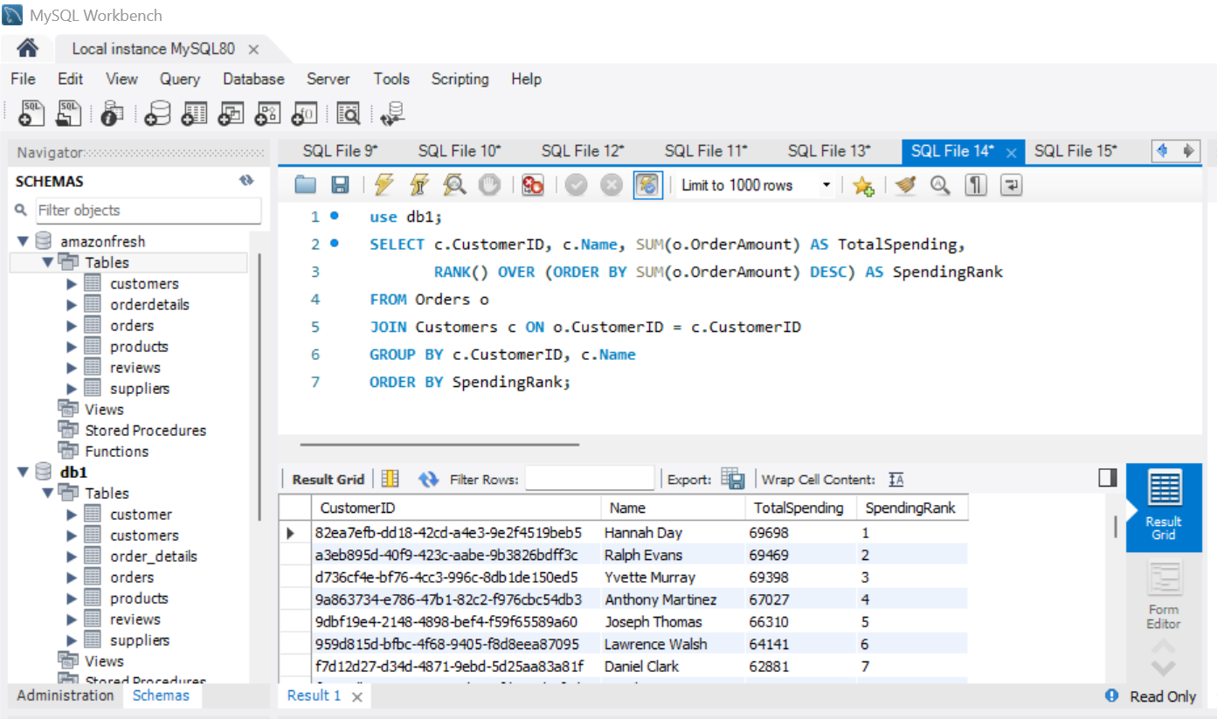
2. Rank customers based on their spending.
RESULTS:

Slide 21
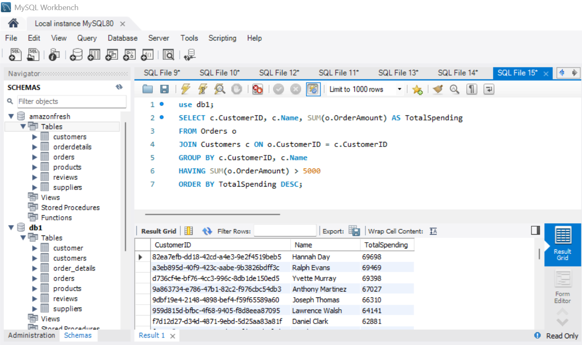
3. Identify customers who have spent more than ₹5,000.
RESULTS:

Slide 22
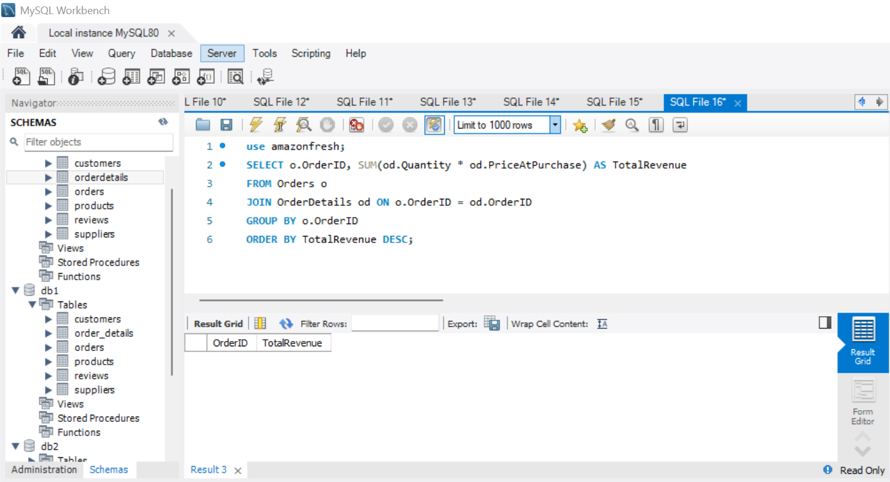
COMPLEX AGGREGATIONS AND JOINS TASK-11
Use SQL to:
1.Join the Orders and Order Details tables to calculate total revenue per order.
RESULTS:

Slide 23
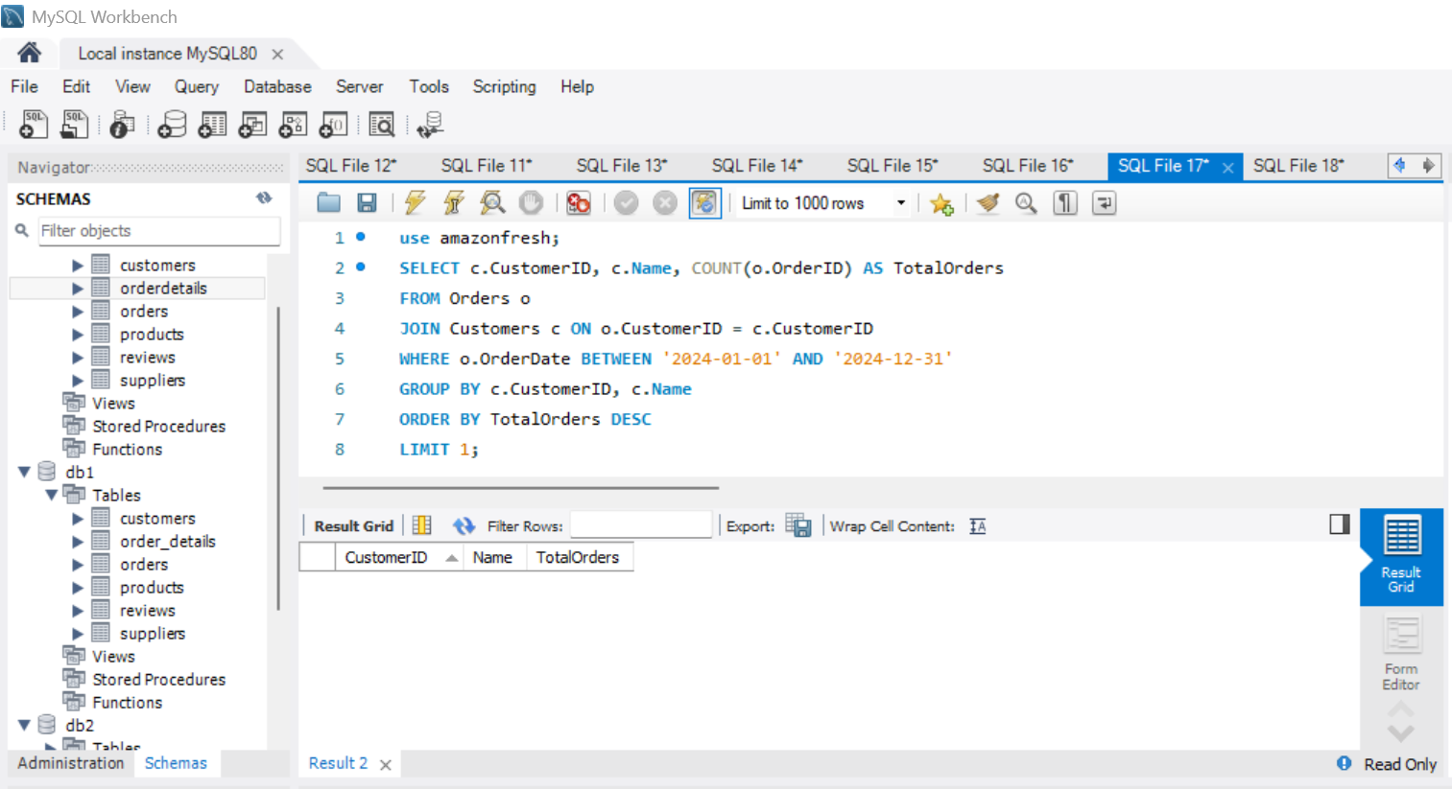
2. Identify customers who placed the most orders in a specific time period.
RESULTS:

Slide 24
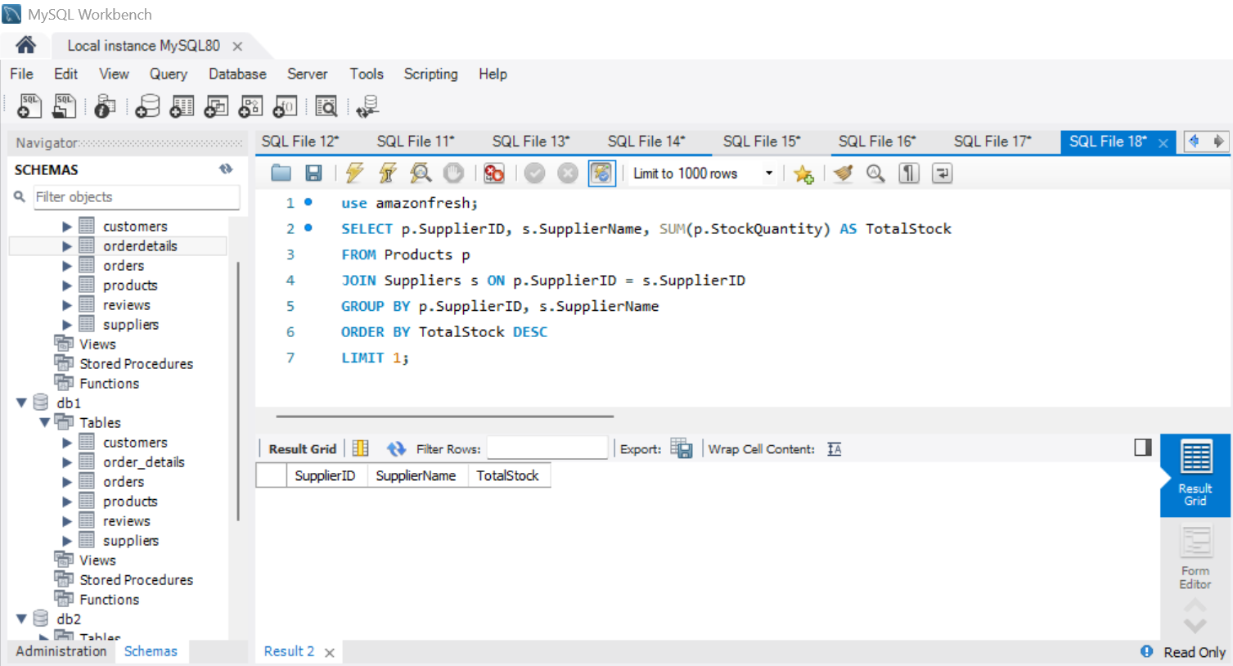
3. Find the supplier with the most products in stock.
RESULTS:

Slide 25
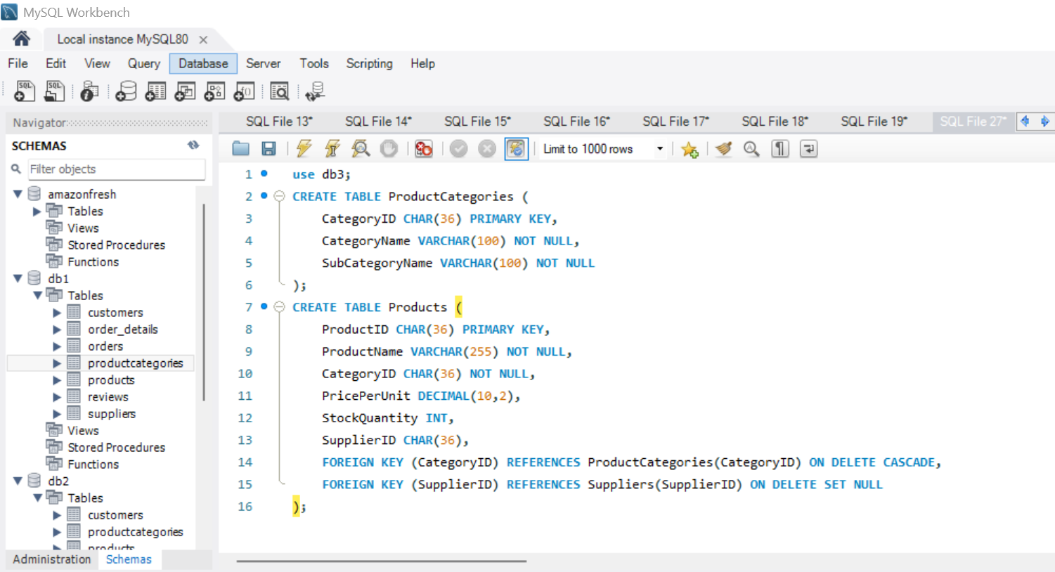
NORMALIZATION TASK-12
Normalize the Products table to 3NF:
1. Separate product categories and subcategories into a new table.
2. Create foreign keys to maintain relationships.
RESULTS:

Slide 26
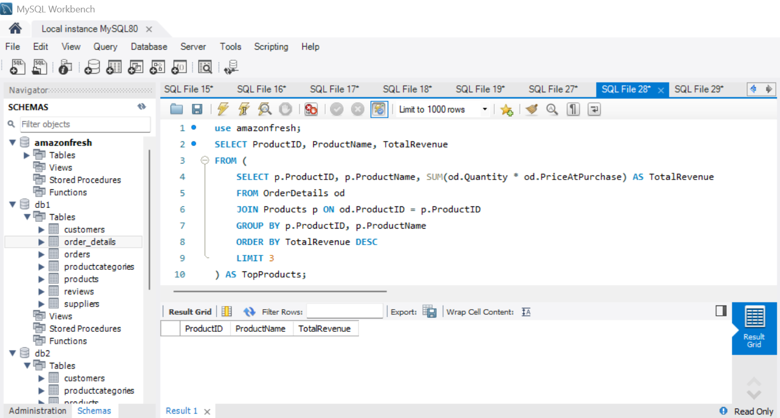
SUBQUERIES AND NESTED QUERIES TASK-13
Write a subquery to:
1.Identify the top 3 products based on sales revenue.
RESULTS:

Slide 27
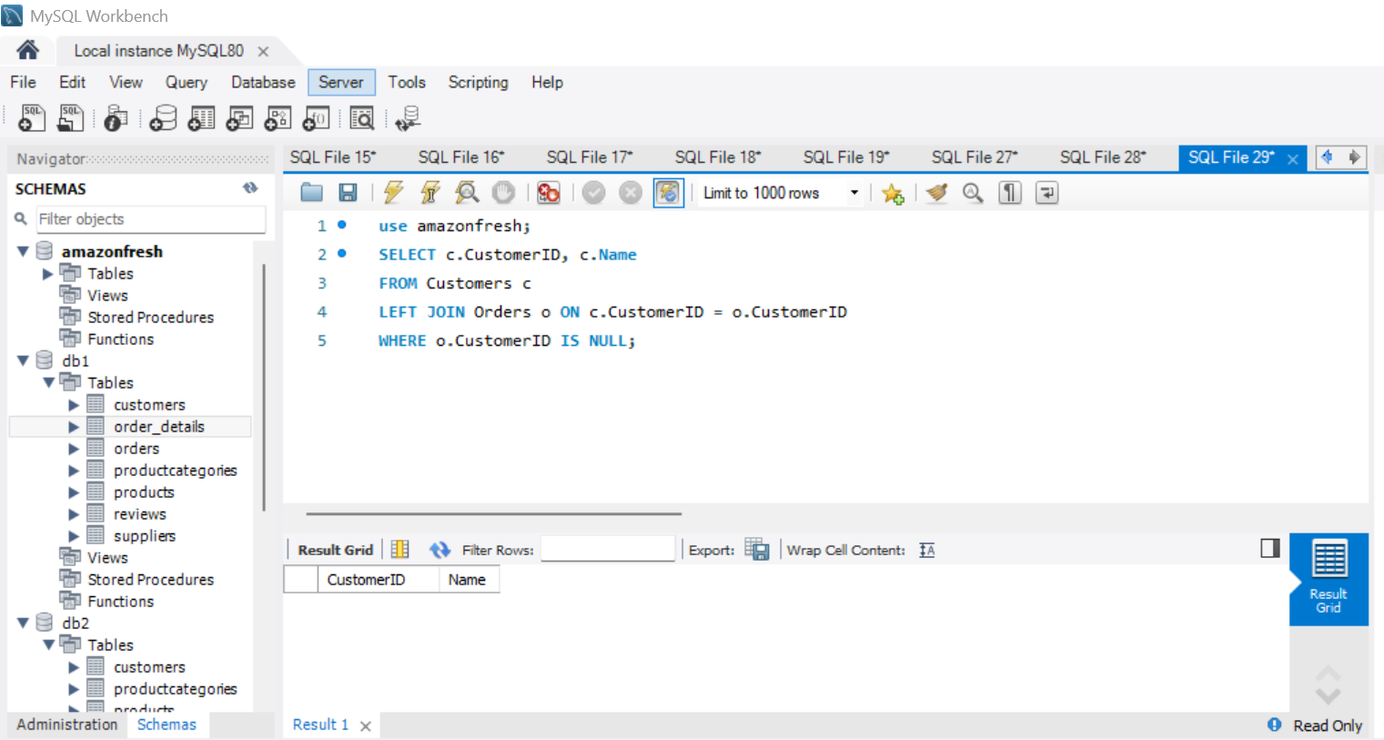
2.Find customers who haven’t placed any orders yet.
RESULTS:

Slide 28
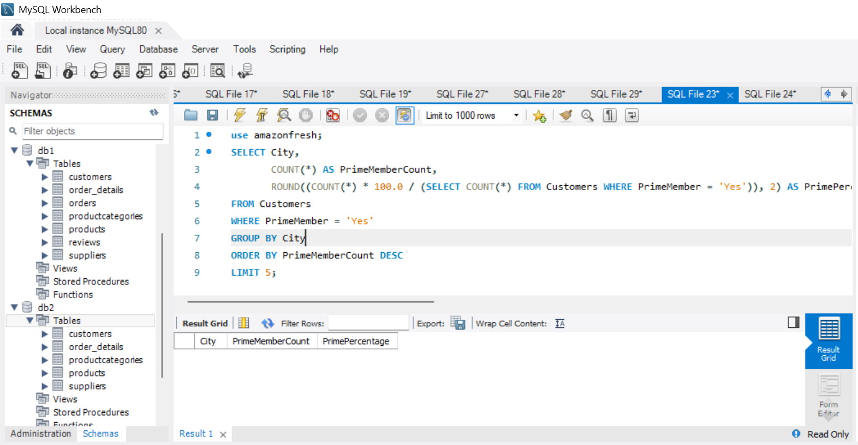
REAL WORLD ANALYSIS TASK-14
Provide actionable insights:
1.Which cities have the highest concentration of Prime members?
RESULTS:

Slide 29
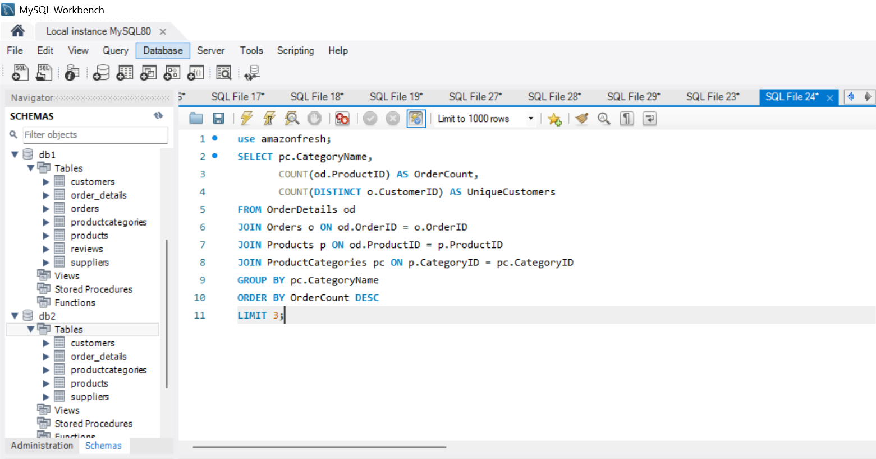
2. What are the top 3 most frequently ordered categories?
RESULTS:

Slide 30
THANKYOU…

